Slide 1
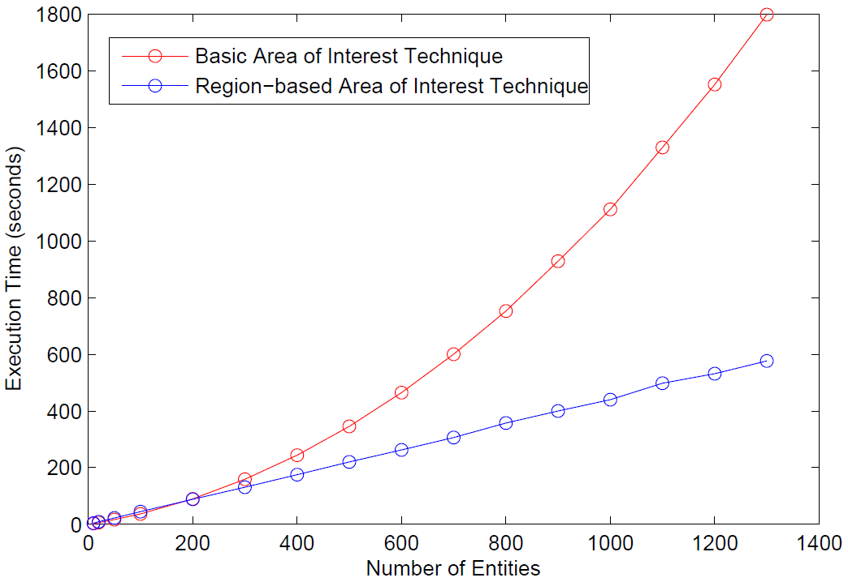
World
World
1
2
3
4
Zones
5
6
7
8
Entities
9
10
11
12
Entities
13
14
15
16
Aura
Area of interest
Part of the world current entity sees
Current entity
Current entity
Regions
Entity
Area of interest

Slide 2
Area of Interest Estimation (T1.1.2)
(a) Entity with a single Area of Interest
subscribes
unsubscribes
subscribes
unsubscribes
Normal trigger
zone
zone
zone
zone
zone
zone
zone
Entity has subscribed to zone
Entity unsubscribes from zone
Entity subscribes to zone
Distance Entity-Region
(b) Entity an inner/outer Area of Interest
subscribes
unsubscribes
Schmitt trigger
zone
zone
zone
zone
zone
zone
zone
Entity has subscribed to zone
Entity unsubscribes from zone
Entity subscribes to zone
Entity
Distance Entity-Zone
Inner Area of Interest
Outer Area of Interest

